Slide 1

3
DIFFERENTIATION RULES

Slide 2
DIFFERENTIATION RULES
We know that, if y = f(x), then the derivative dy/dx can be interpreted as
the rate of change of y with respect to x.

Slide 3
DIFFERENTIATION RULES
3.7
Rates of Change in the
Natural and Social Sciences
In this section, we will examine:
Some applications of the rate of change to physics,
chemistry, biology, economics, and other sciences.

Slide 4
RATES OF CHANGE
Let’s recall from Section 2.7 the basic idea behind rates of change.
  If x changes from x₁ to x₂, then the change in x
  is ∆x = x₂ – x₁
  The corresponding change in y is ∆y = f(x₂) – f(x₁)

Slide 5
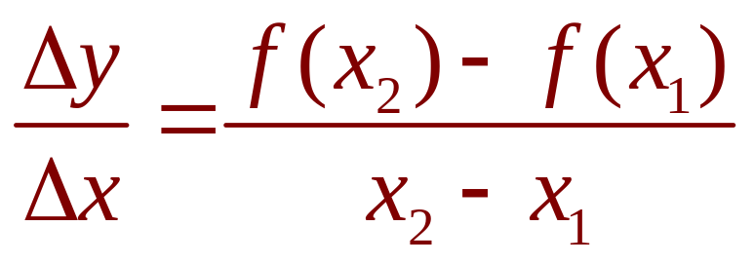
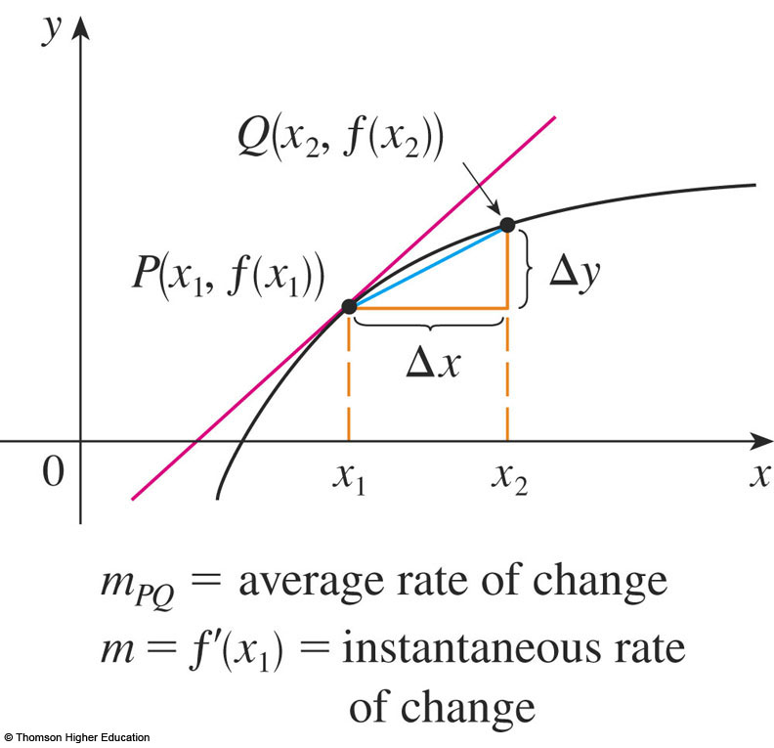
AVERAGE RATE
The difference quotient
is the average rate of change of y with
respect to x over the interval [x₁, x₂].
  It can be interpreted as
  the slope of the secant
  line PQ.

Slide 6
INSTANTANEOUS RATE
Its limit as ∆x → 0 is the derivative f’(x₁).
  This can therefore be interpreted as the instantaneous rate of change of y with respect to x or the slope of
  the tangent line at P(x₁,f(x₁)).

Slide 7
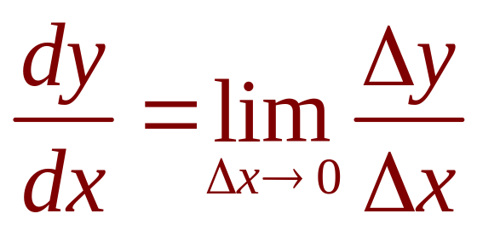
RATES OF CHANGE
Using Leibniz notation, we write the process in the form

Slide 8
RATES OF CHANGE
Whenever the function y = f(x) has a specific interpretation in one of the sciences, its derivative will have a specific interpretation
as a rate of change.
  As we discussed in Section 2.7, the units for dy/dx
  are the units for y divided by the units for x.

Slide 9
NATURAL AND SOCIAL SCIENCES
We now look at some of these interpretations in the natural and social sciences.

Slide 10
PHYSICS
Let s = f(t) be the position function of
a particle moving in a straight line.
Then,
  ∆s/∆t represents the average velocity over
  a time period ∆t
  v = ds/dt represents the instantaneous velocity
  (velocity is the rate of change of displacement
  with respect to time)
  The instantaneous rate of change of velocity with respect to time is acceleration: a(t) = v’(t) = s’’(t)

Slide 11
PHYSICS
These were discussed in Sections 2.7 and 2.8
  However, now that we know the differentiation formulas, we are able to solve problems involving the motion of objects more easily.

Slide 12
PHYSICS
Example 1
The position of a particle is given by
the equation s = f(t) = t³ – 6t² + 9t where
t is measured in seconds and s in meters.
  Find the velocity at time t.
  What is the velocity after 2 s? After 4 s?
  When is the particle at rest?

Slide 13
PHYSICS
Example 1
  When is the particle moving forward
  (that is, in the positive direction)?
  Draw a diagram to represent the motion
  of the particle.
  Find the total distance traveled by the particle
  during the first five seconds.

Slide 14
PHYSICS
Example 1
  Find the acceleration at time t and after 4 s.
  Graph the position, velocity, and acceleration functions for 0 ≤ t ≤ 5.
  When is the particle speeding up?
  When is it slowing down?

Slide 15
PHYSICS
Example 1 a
The velocity function is the derivative
of the position function.
s = f(t) = t³ – 6t² + 9t
v(t) = ds/dt = 3t² – 12t + 9

Slide 16
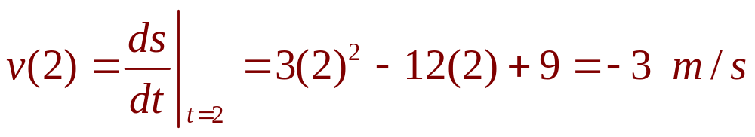
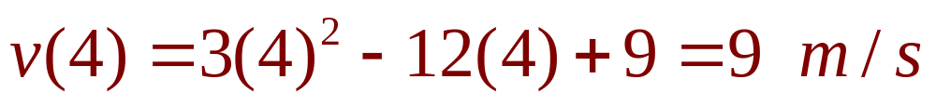
PHYSICS
Example 1 b
The velocity after 2 s means the instantaneous velocity when t = 2, that is,
The velocity after 4 s is:

Slide 17
PHYSICS
Example 1 c
The particle is at rest when v(t) = 0,
that is,
3t² - 12t + 9 = 3(t² - 4t + 3) = 3(t - 1)(t - 3) = 0
  This is true when t = 1 or t = 3.
  Thus, the particle is at rest after 1 s and after 3 s.

Slide 18
PHYSICS
Example 1 d
The particle moves in the positive direction when v(t) > 0, that is,
3t² – 12t + 9 = 3(t – 1)(t – 3) > 0
  This inequality is true when both factors are positive
  (t > 3) or when both factors are negative (t < 1).
  Thus the particle moves in the positive direction
  in the time intervals t < 1 and t > 3.
  It moves backward (in the negative direction)
  when 1 < t < 3.

Slide 19
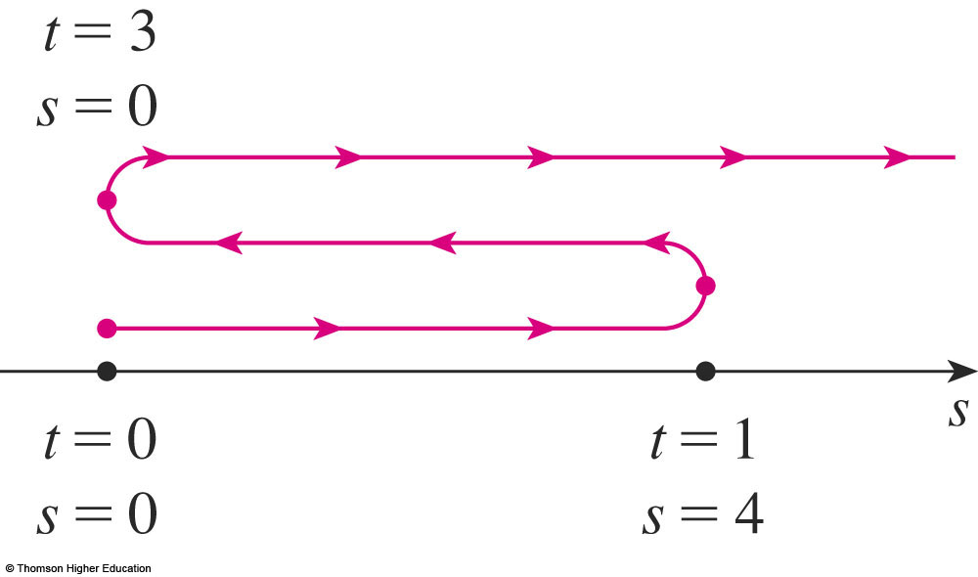
PHYSICS
Example 1 e
Using the information from (d), we make a schematic sketch of the motion of the particle back and forth along a line (the s -axis).

Slide 20
PHYSICS
Example 1 f
Due to what we learned in (d) and (e),
we need to calculate the distances traveled during the time intervals [0, 1], [1, 3], and
[3, 5] separately.

Slide 21
PHYSICS
Example 1 f
The distance traveled in the first second is:
|f(1) – f(0)| = |4 – 0| = 4 m
From t = 1 to t = 3, it is:
|f(3) – f(1)| = |0 – 4| = 4 m
From t = 3 to t = 5, it is:
|f(5) – f(3)| = |20 – 0| = 20 m
  The total distance is 4 + 4 + 20 = 28 m

Slide 22
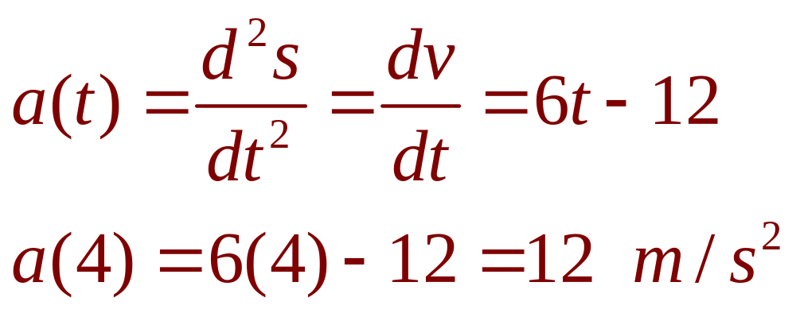
PHYSICS
Example 1 g
The acceleration is the derivative of
the velocity function:

Slide 23
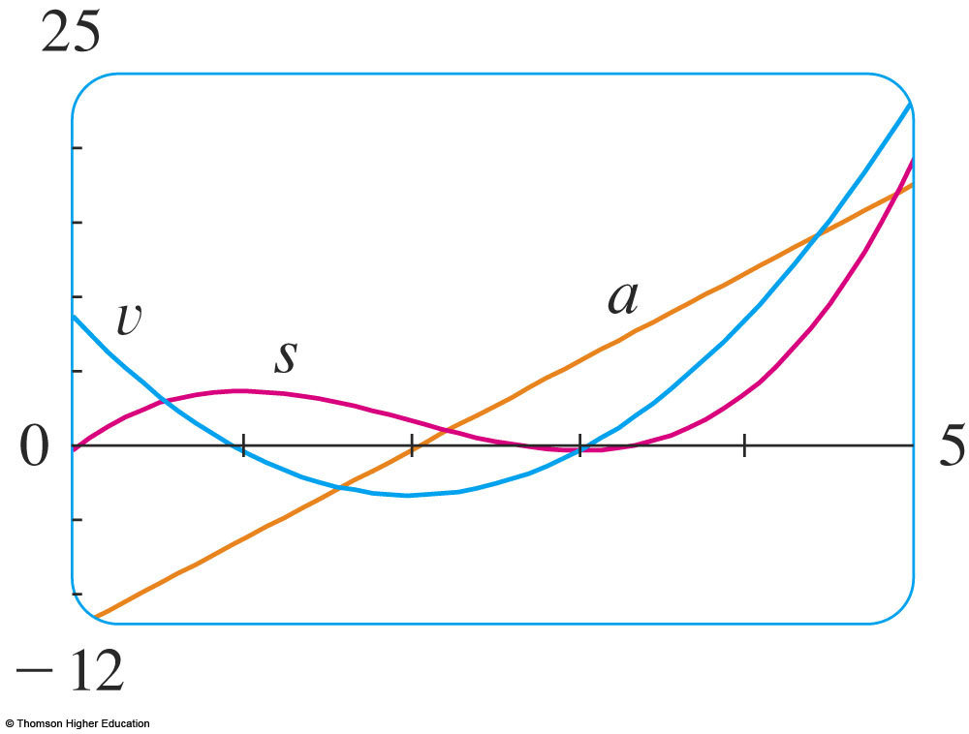
PHYSICS
Example 1 h
The figure shows the graphs
of s, v, and a.

Slide 24
PHYSICS
Example 1 i
The particle speeds up when the velocity is positive and increasing (v and a are both positive) and when the velocity is negative
and decreasing (v and a are both negative).
  In other words, the particle speeds up when
  the velocity and acceleration have the same sign.
  The particle is pushed in the same direction it is moving.

Slide 25
PHYSICS
Example 1 i
From the figure, we see that this happens when 1 < t < 2 and when t > 3.

Slide 26
PHYSICS
Example 1 i
The particle slows down when v and a have opposite signs—that is, when 0 ≤ t < 1 and when 2 < t < 3.

Slide 27
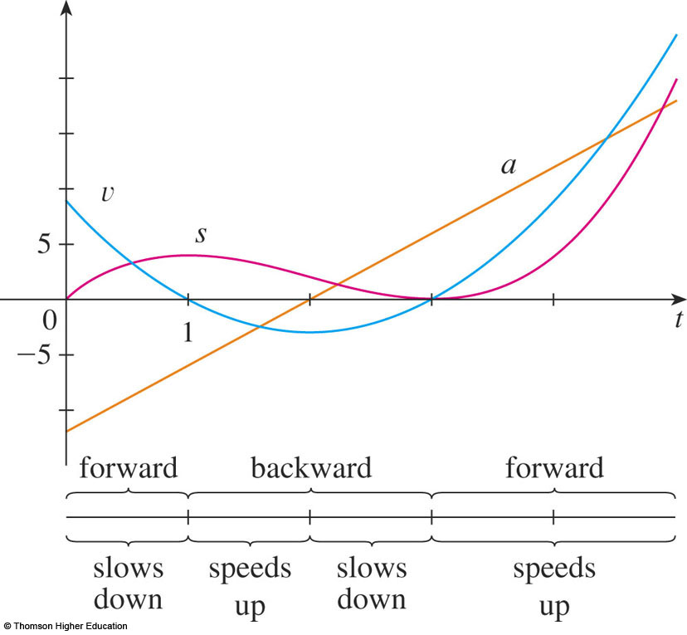
PHYSICS
Example 1 i
This figure summarizes the motion
of the particle.

Slide 28
PHYSICS
Example 2
If a rod or piece of wire is homogeneous,
then its linear density is uniform and is
defined as the mass per unit length (ρ = m/l) and measured in kilograms per meter.

Slide 29
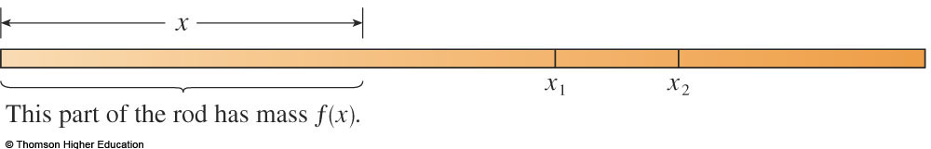
PHYSICS
Example 2
However, suppose that the rod is not homogeneous but that its mass measured from its left end to a point x
is m = f(x).

Slide 30
PHYSICS
Example 2
The mass of the part of the rod that lies between x = x₁ and x = x₂ is given by ∆m = f(x₂) – f(x₁)

Slide 31
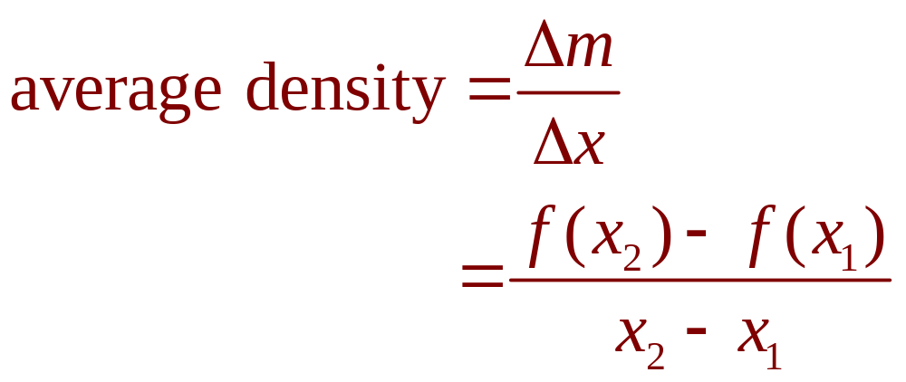
PHYSICS
Example 2
So, the average density of that part
is:

Slide 32
PHYSICS
Example 2
If we now let ∆x → 0 (that is, x₂ → x₁),
we are computing the average density over smaller and smaller intervals.

Slide 33
LINEAR DENSITY
The linear density ρ at x₁ is the limit of these average densities as ∆x → 0.
  That is, the linear density is the rate of change
  of mass with respect to length.

Slide 34
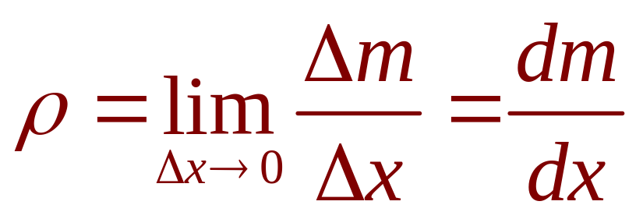
LINEAR DENSITY
Example 2
Symbolically,
  Thus, the linear density of the rod is
  the derivative of mass with respect to length.

Slide 35
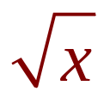
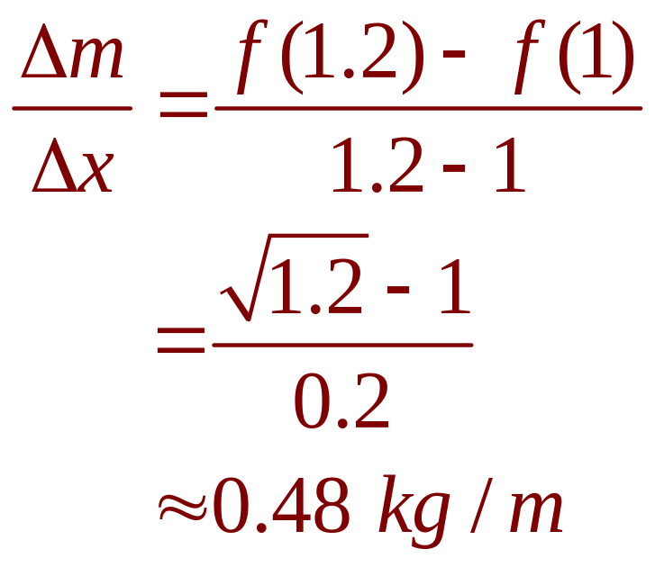
PHYSICS
Example 2
For instance, if m = f(x) = , where x is measured in meters and m in kilograms,
then the average density of the part of the rod given by 1≤ x ≤ 1.2 is:

Slide 36
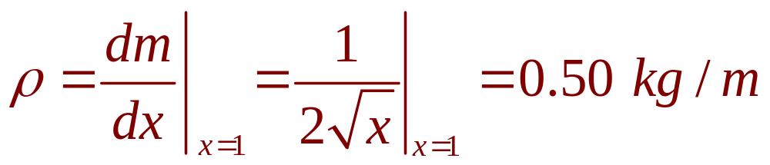
PHYSICS
Example 2
The density right at x = 1 is:

Slide 37

PHYSICS
Example 3
A current exists whenever electric charges move.
  The figure shows part of a wire and electrons moving through a shaded plane surface.

Slide 38
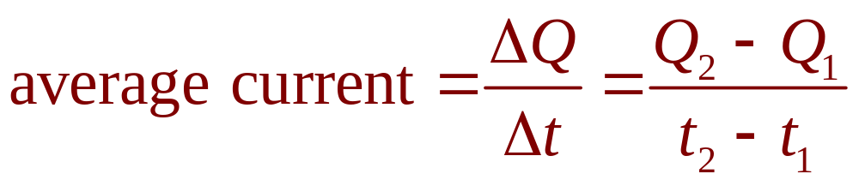
PHYSICS
Example 3
If ∆Q is the net charge that passes through this surface during a time period ∆t, then
the average current during this time interval
is defined as:

Slide 39
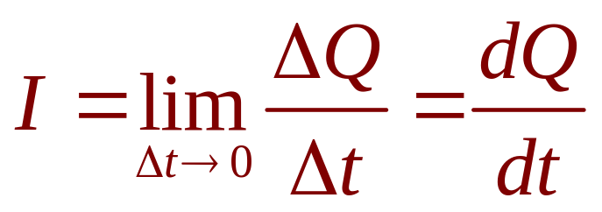
PHYSICS
Example 3
If we take the limit of this average current over smaller and smaller time intervals, we get what is called the current I at a given time t₁:
  Thus, the current is the rate at which charge
  flows through a surface.
  It is measured in units of charge per unit time
  (often coulombs per second—called amperes).

Slide 40
PHYSICS
Velocity, density, and current are not the only rates of change important in physics.
Others include:
  Power (the rate at which work is done)
  Rate of heat flow
  Temperature gradient (the rate of change of
  temperature with respect to position)
  Rate of decay of a radioactive substance in
  nuclear physics

Slide 41
CHEMISTRY
Example 4
A chemical reaction results in the formation
of one or more substances (products) from one or more starting materials (reactants).
  For instance, the ‘equation’
  2H₂ + O₂ → 2H₂O
  indicates that two molecules of hydrogen and
  one molecule of oxygen form two molecules of water.

Slide 42
CONCENTRATION
Example 4
Let’s consider the reaction A + B → C
where A and B are the reactants and C is
the product.
  The concentration of a reactant A is the number
  of moles (6.022 X 10²³ molecules) per liter and
  is denoted by [A].
  The concentration varies during a reaction.
  So, [A], [B], and [C] are all functions of time (t).

Slide 43
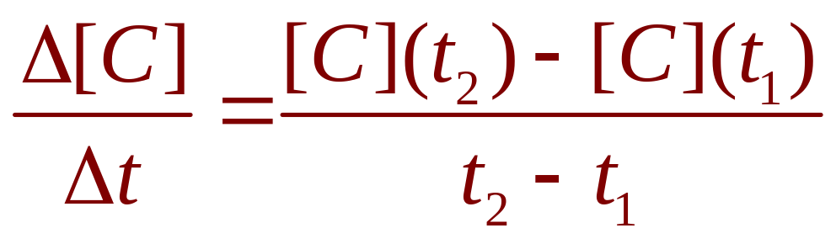
AVERAGE RATE
Example 4
The average rate of reaction of
the product C over a time interval
t₁ ≤ t ≤ t₂ is:

Slide 44
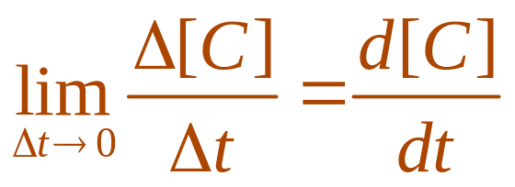
INSTANTANEOUS RATE
Example 4
However, chemists are more interested in the instantaneous rate of reaction.
  This is obtained by taking the limit of
  the average rate of reaction as the time
  interval ∆t approaches 0:
  rate of reaction =

Slide 45
PRODUCT CONCENTRATION
Example 4
Since the concentration of the product increases as the reaction proceeds,
the derivative d[C]/dt will be positive.
  So, the rate of reaction of C is positive.

Slide 46
REACTANT CONCENTRATION
Example 4
However, the concentrations of the reactants decrease during the reaction.
  So, to make the rates of reaction of A and B
  positive numbers, we put minus signs in front
  of the derivatives d[A]/dt and d[B]/dt.

Slide 47
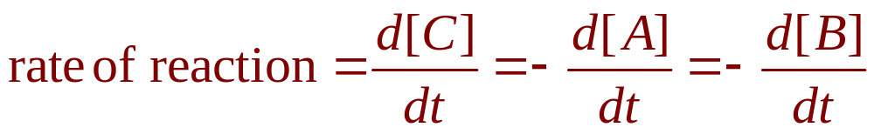
CHEMISTRY
Example 4
Since [A] and [B] each decrease
at the same rate that [C] increases,
we have:

Slide 48
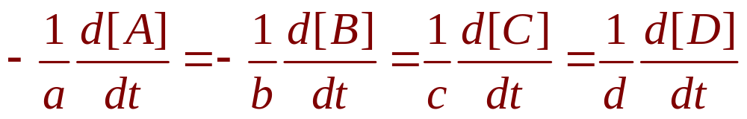
CHEMISTRY
Example 4
More generally, it turns out that for a reaction of the form
aA + bB → cC + dD
we have

Slide 49
CHEMISTRY
Example 4
The rate of reaction can be determined from data and graphical methods.
  In some cases, there are explicit formulas for
  the concentrations as functions of time—which enable us to compute the rate of reaction.

Slide 50
COMPRESSIBILITY
Example 5
One of the quantities of interest in thermodynamics is compressibility.
  If a given substance is kept at a constant temperature, then its volume V depends on its pressure P.
  We can consider the rate of change of volume with respect to pressure—namely, the derivative dV/dP.
  As P increases, V decreases, so dV/dP < 0.

Slide 51
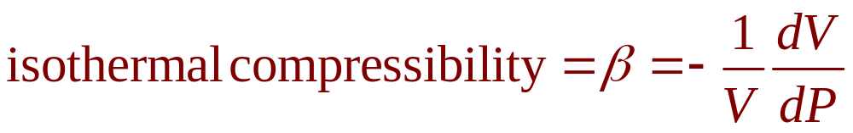
COMPRESSIBILITY
Example 5
The compressibility is defined by introducing
a minus sign and dividing this derivative by
the volume V:
  Thus, β measures how fast, per unit volume,
  the volume of a substance decreases as the pressure on it increases at constant temperature.

Slide 52
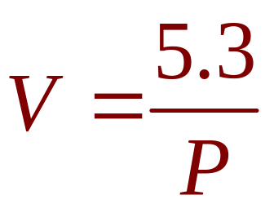
CHEMISTRY
Example 5
For instance, the volume V (in cubic meters) of a sample of air at 25ºC was found to be related to the pressure P (in kilopascals) by the equation

Slide 53
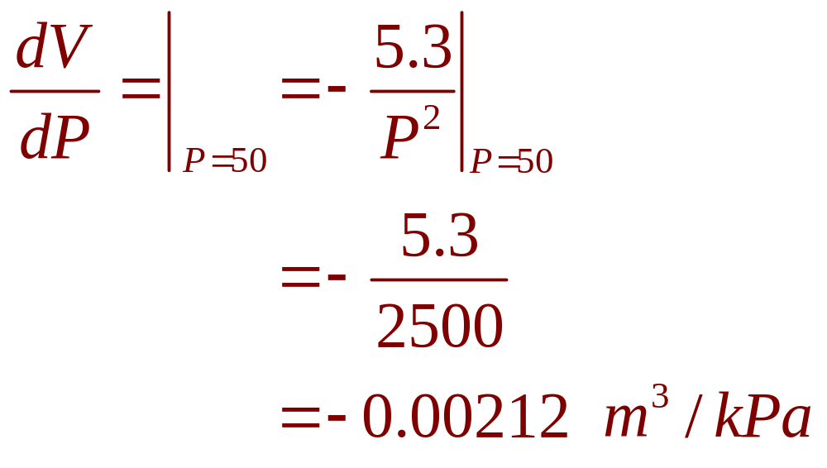
CHEMISTRY
Example 5
The rate of change of V with respect to P when P = 50 kPa is:

Slide 54
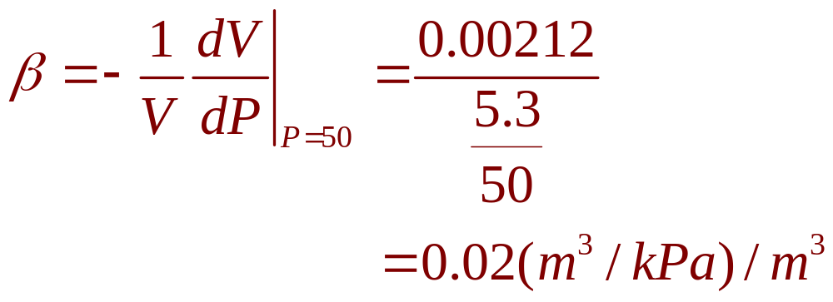
CHEMISTRY
Example 5
The compressibility at that pressure is:

Slide 55
BIOLOGY
Example 6
Let n = f(t) be the number of
individuals in an animal or plant population at time t.
  The change in the population size between
  the times t = t₁ and t = t₂ is ∆n = f(t₂) – f(t₁)

Slide 56
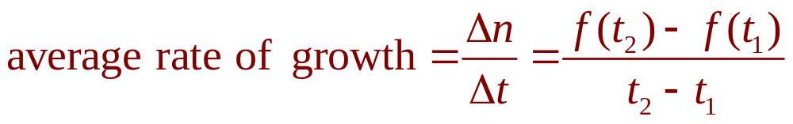
AVERAGE RATE
So, the average rate of growth during
the time period t₁ ≤ t ≤ t₂ is:

Slide 57
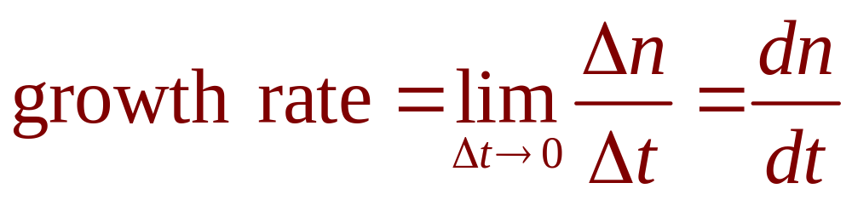
INSTANTANEOUS RATE
Example 6
The instantaneous rate of growth is obtained from this average rate of growth by letting
the time period ∆t approach 0:

Slide 58
BIOLOGY
Example 6
Strictly speaking, this is not quite accurate.
  This is because the actual graph of a population
  function n = f(t) would be a step function that is discontinuous whenever a birth or death occurs
  and, therefore, not differentiable.

Slide 59
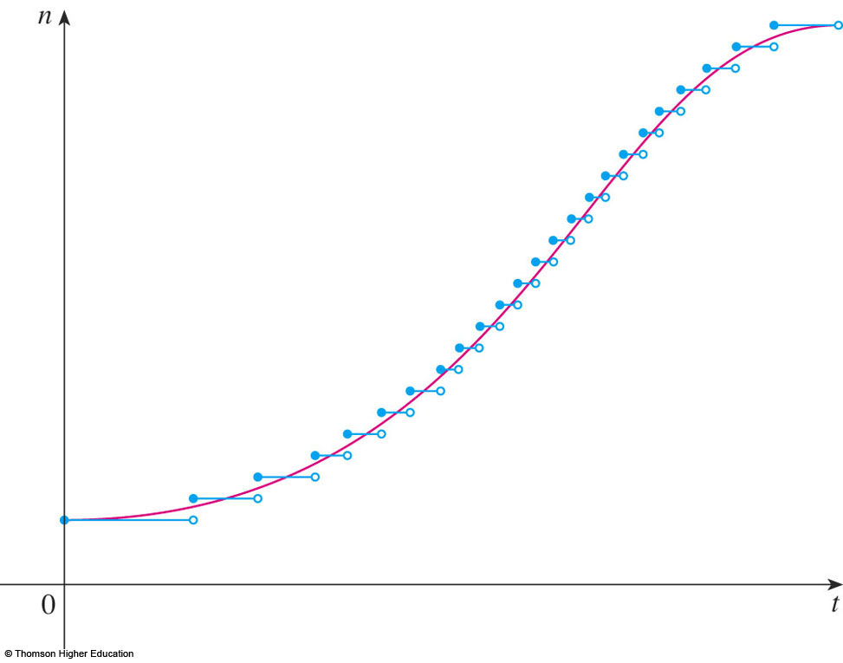
BIOLOGY
Example 6
However, for a large animal or plant population, we can replace the graph by
a smooth approximating curve.

Slide 60
BIOLOGY
Example 6
To be more specific, consider
a population of bacteria in
a homogeneous nutrient medium.
  Suppose that, by sampling the population
  at certain intervals, it is determined that
  the population doubles every hour.

Slide 61
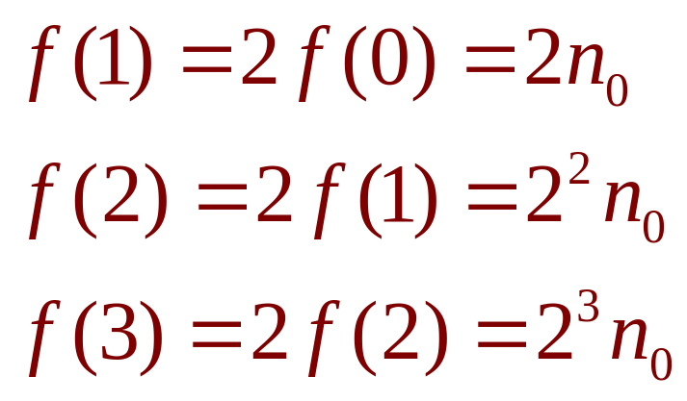
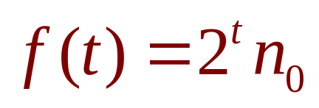
BIOLOGY
Example 6
If the initial population is n₀ and the time t
is measured in hours, then
and, in general,
  The population function is n = n₀2^{t}

Slide 62
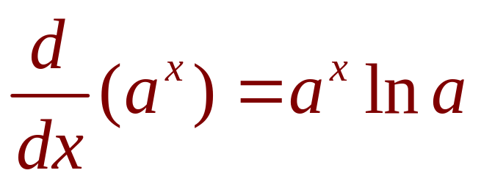
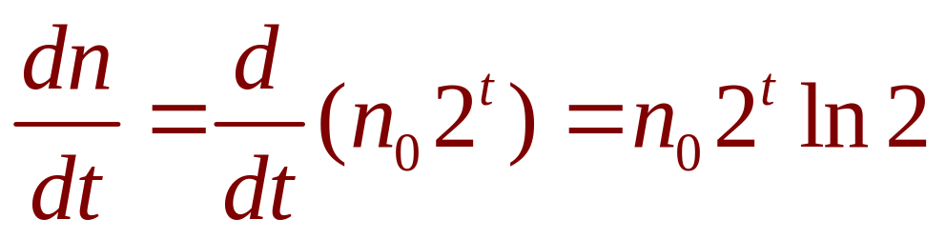
BIOLOGY
Example 6
In Section 3.4, we showed that:
So, the rate of growth of the bacteria population at time t is:

Slide 63
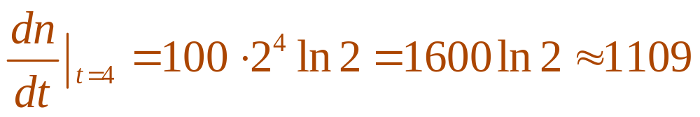
BIOLOGY
Example 6
For example, suppose that we start with
an initial population of n₀ = 100 bacteria.
  Then, the rate of growth after 4 hours is:
  This means that, after 4 hours, the bacteria population
  is growing at a rate of about 1109 bacteria per hour.

Slide 64
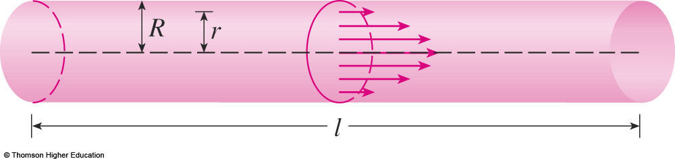
BIOLOGY
Example 7
When we consider the flow of blood through
a blood vessel, such as a vein or artery, we can model the shape of the blood vessel by
a cylindrical tube with radius R and length l.

Slide 65
BIOLOGY
Example 7
Due to friction at the walls of the tube,
the velocity v of the blood is greatest along
the central axis of the tube and decreases
as the distance r from the axis increases
until v becomes 0 at the wall.

Slide 66
BIOLOGY
Example 7
The relationship between v and r is given by the law of laminar flow discovered by the French physician Jean-Louis-Marie Poiseuille in 1840.

Slide 67
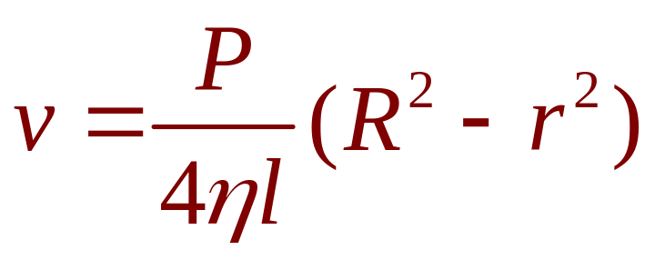
LAW OF LAMINAR FLOW
E. g. 7—Eqn. 1
The law states that
where η is the viscosity of the blood and P
is the pressure difference between the ends
of the tube.
  If P and l are constant, then v is a function of r
  with domain [0, R].

Slide 68
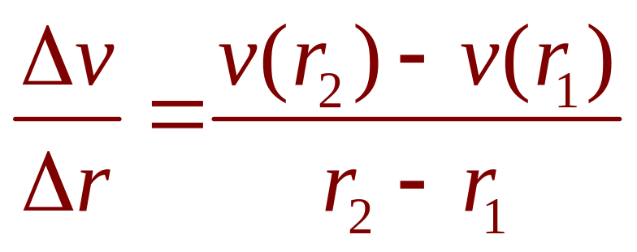
AVERAGE RATE
Example 7
The average rate of change of the velocity as we move from r = r₁ outward to r = r₂
is given by:

Slide 69
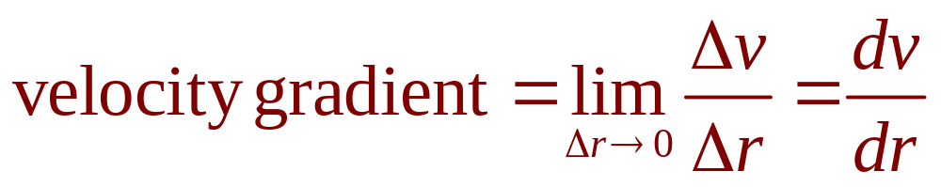
VELOCITY GRADIENT
Example 7
If we let ∆r → 0, we obtain the velocity gradient—that is, the instantaneous rate
of change of velocity with respect to r:

Slide 70
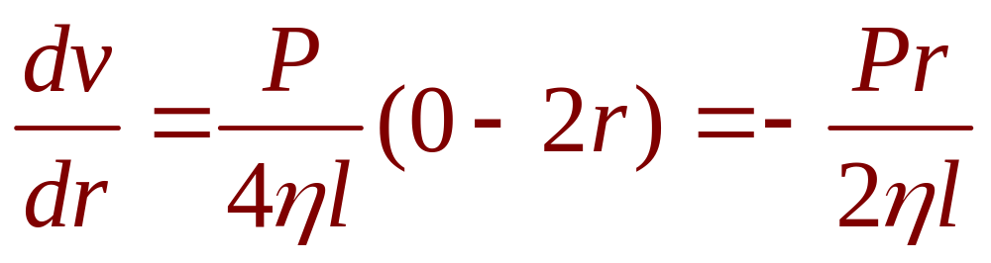
BIOLOGY
Example 7
Using Equation 1, we obtain:

Slide 71
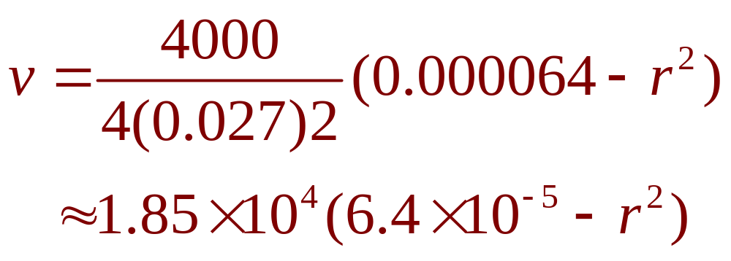
BIOLOGY
Example 7
For one of the smaller human arteries,
we can take η = 0.027, R = 0.008 cm,
l = 2 cm, and P = 4000 dynes/cm².
This gives:

Slide 72
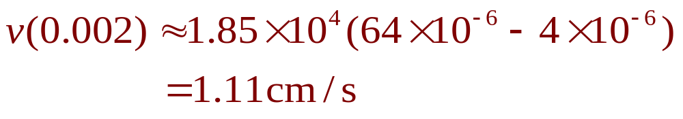
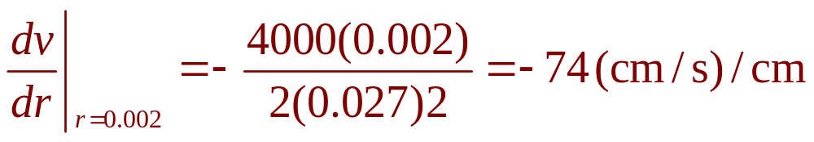
BIOLOGY
Example 7
At r = 0.002 cm, the blood is flowing at:
The velocity gradient at that point is:

Slide 73
BIOLOGY
Example 7
To get a feeling of what this statement means, let’s change our units from centimeters to micrometers (1 cm = 10,000 μm).
  Then, the radius of the artery is 80 μm.
  The velocity at the central axis is 11,850 μm/s,
  which decreases to 11,110 μm/s at a distance
  of r = 20 μm.

Slide 74
BIOLOGY
Example 7
The fact that dv/dr = -74 (μm/s)/μm means that, when r = 20 μm, the velocity is decreasing at a rate of about 74 μm/s
for each micrometer that we proceed away
from the center.

Slide 75
ECONOMICS
Example 8
Suppose C(x) is the total cost that
a company incurs in producing x units
of a certain commodity.
The function C is called a cost function.

Slide 76
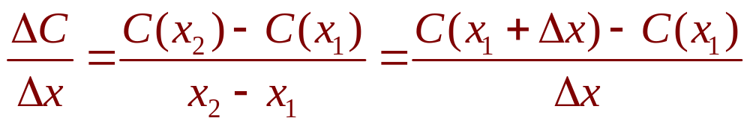
AVERAGE RATE
Example 8
If the number of items produced is increased from x₁ to x₂, then the additional cost is ∆C = C(x₂) - C(x₁) and the average rate
of change of the cost is:

Slide 77
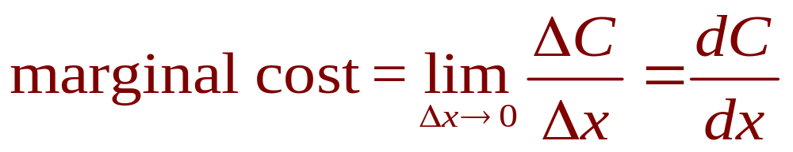
MARGINAL COST
Example 8
The limit of this quantity as ∆x → 0, that is,
the instantaneous rate of change of cost with respect to the number of items produced,
is called the marginal cost by economists:

Slide 78
ECONOMICS
Example 8
As x often takes on only integer values,
it may not make literal sense to let ∆x approach 0.
  However, we can always replace C(x) by a
  smooth approximating function—as in Example 6.

Slide 79
ECONOMICS
Example 8
Taking ∆x = 1 and n large (so that ∆x is small compared to n), we have:
C’(n) ≈ C(n + 1) – C(n)
  Thus, the marginal cost of producing n units
  is approximately equal to the cost of producing
  one more unit [the (n + 1)st unit].

Slide 80
ECONOMICS
Example 8
It is often appropriate to represent a total cost function by a polynomial
C(x) = a + bx + cx² + dx³
where a represents the overhead cost (rent, heat, and maintenance) and the other terms represent the cost of raw materials, labor,
and so on.

Slide 81
ECONOMICS
Example 8
The cost of raw materials may be
proportional to x.
However, labor costs might depend partly on higher powers of x because of overtime costs and inefficiencies involved in large-scale operations.

Slide 82
ECONOMICS
Example 8
For instance, suppose a company
has estimated that the cost (in dollars)
of producing x items is:
C(x) = 10,000 + 5x + 0.01x²
  Then, the marginal cost function is:
  C’(x) = 5 + 0.02x

Slide 83
ECONOMICS
Example 8
The marginal cost at the production level
of 500 items is:
C’(500) = 5 + 0.02(500) = $15/item
  This gives the rate at which costs are increasing
  with respect to the production level when x = 500
  and predicts the cost of the 501st item.

Slide 84
ECONOMICS
Example 8
The actual cost of producing the 501st item is:
C(501) – C(500) =
[10,000 + 5(501) + 0.01(501)²]
– [10,000 + 5(500) + 0.01(500)²]
=$15.01
  Notice that C’(500) ≈ C(501) – C(500)

Slide 85
ECONOMICS
Example 8
Economists also study marginal demand, marginal revenue, and marginal profit—which are the derivatives of the demand, revenue, and profit functions.
  These will be considered in Chapter 4—after we have developed techniques for finding the maximum and minimum values of functions.

Slide 86
GEOLOGY AND ENGINEERING
Rates of change occur in all
the sciences.
  A geologist is interested in knowing the rate
  at which an intruded body of molten rock cools
  by conduction of heat into surrounding rocks.
  An engineer wants to know the rate at which
  water flows into or out of a reservoir.

Slide 87
GEOGRAPHY AND METEOROLOGY
  An urban geographer is interested in the rate
  of change of the population density in a city as
  the distance from the city center increases.
  A meteorologist is concerned with the rate
  of change of atmospheric pressure with respect
  to height.

Slide 88
PSYCHOLOGY
In psychology, those interested in learning theory study the so-called learning curve.
  This graphs the performance P(t) of someone learning
  a skill as a function of the training time t.
  Of particular interest is the rate at which performance improves as time passes—that is, dP/dt.

Slide 89
SOCIOLOGY
In sociology, differential calculus is
used in analyzing the spread of rumors
(or innovations or fads or fashions).
  If p(t) denotes the proportion of a population that
  knows a rumor by time t, then the derivative dp/dt represents the rate of spread of the rumor.

Slide 90
A SINGLE IDEA, MANY INTERPRETATIONS
You have learned about many special
cases of a single mathematical concept,
the derivative.
  Velocity, density, current, power, and temperature gradient in physics
  Rate of reaction and compressibility in chemistry
  Rate of growth and blood velocity gradient in biology
  Marginal cost and marginal profit in economics
  Rate of heat flow in geology
  Rate of improvement of performance in psychology
  Rate of spread of a rumor in sociology

Slide 91
A SINGLE IDEA, MANY INTERPRETATIONS
This is an illustration of the fact that
part of the power of mathematics lies
in its abstractness.
  A single abstract mathematical concept (such as
  the derivative) can have different interpretations
  in each of the sciences.

Slide 92
A SINGLE IDEA, MANY INTERPRETATIONS
When we develop the properties of
the mathematical concept once and for all,
we can then turn around and apply these results to all the sciences.
  This is much more efficient than developing properties of special concepts in each separate science.

Slide 93
A SINGLE IDEA, MANY INTERPRETATIONS
The French mathematician Joseph Fourier (1768–1830) put it succinctly:
“Mathematics compares the most
diverse phenomena and discovers
the secret analogies that unite them.”

